Slide 1
Exponential and Logarithmic Functions
Algebra 2
Chapter 7
Notes:
Algebra II 7

Slide 2
This Slideshow was developed to accompany the textbook
  Larson Algebra 2
  By Larson, R., Boswell, L., Kanold, T. D., & Stiff, L.
  2011 Holt McDougal
Some examples and diagrams are taken from the textbook.
Slides created by
Richard Wright, Andrews Academy
rwright@andrews.edu

Slide 3

7.1 Graph Exponential Growth Functions

Slide 4
8-1 Exponential Growth
Notes:
How much work will be done the last week of school?
Formula is 2^{n-1}
Plug in 36: 2³⁶⁻¹ = 3.436x10¹⁰ seconds → 9544371.769 hours → 397682.157 days → 1088.8 years

Slide 5
WRIGHT

Slide 6
7.1 Graph Exponential Growth Functions
Exponential Function
  y = b^{x}
  Base (b) is a positive number other than 1
y = 2^{x}

Slide 7
Notes:
Graph
y=2^{x}
y=1/3 * 2^{x}
y=3*2^{x}
y=-3*2^{x}

Slide 8
7.1 Graph Exponential Growth Functions
y = a · 2^{x}
  y-intercept = a
  x-axis is the asymptote of graph

Slide 9
7.1 Graph Exponential Growth Functions
Exponential Growth Function
  y = a · b^{x – h} + k
To graph
  Start with y = b^{x}
  Multiply y-coordinates by a
  Move up k and right h
  (or make table of values)
Properties of the graph
y-intercept = a (if h and k=0)
y = k is asymptote
Domain is all real numbers
Range
  y > k if a > 0
  y < k if a < 0

Slide 10
7.1 Graph Exponential Growth Functions
Graph
y = 3 · 2^{x – 3} – 2

Slide 11
7.1 Graph Exponential Growth Functions
Exponential Growth Model (word problems)
  y = a(1 + r)^{t}
    y = current amount
    a = initial amount
    r = growth percent
    1 + r = growth factor
    t = time

Slide 12

7.1 Graph Exponential Growth Functions
Compound Interest
$A=P{\left(1+\frac{r}{n}\right)}^{nt}$
    A = current amount
    P = principle (initial amount)
    r = percentage rate
    n = number of times compounded per year
    t = time in years

Slide 13
7.1 Graph Exponential Growth Functions
If you put $200 into a CD (Certificate of Deposit) that earns 4% interest, how much money will you have after 2 years if you compound the interest monthly? daily?
Notes:
Monthly: 200(1+.04/12)^{12*2} = $216.63
Daily: 200(1+.04/365)^{365*2} = $216.66

Slide 14
Quiz
7.1 Homework Quiz

Slide 15
7.2 Graph Exponential Decay Functions
Exponential Decay
  y = a·b^{x}
  a > 0
  0 < b < 1
Follows same rules as growth
  y-intercept = a
  y = k is asymptote
  y = a · b^{x – h} + k
y = (½)^{x}

Slide 16
7.2 Graph Exponential Decay Functions
Graph
y = 2 · (½)^{x + 3} – 2

Slide 17
7.2 Graph Exponential Decay Functions
Exponential Decay Model (word problems)
  y = a(1 - r)^{t}
    y = current amount
    a = initial amount
    r = decay percent
    1 – r = decay factor
    t = time

Slide 18
7.2 Graph Exponential Decay Functions
A new car cost $23000. The value decreases by 15% each year. Write a model of this decay. How much will the car be worth in 5 years? 10 years?
Notes:
y = 23000(1-0.15)^{t} → y = 23000(0.85)^{t}
5 years: y = 23000(0.85)⁵ = $10205.22
10 years: y = 23000(0.85)¹⁰ = $4528.11

Slide 19
Quiz
7.2 Homework Quiz

Slide 20
7.3 Use Functions Involving e
In math, there are some special numbers like π or i
Today we will learn about e

Slide 21

7.3 Use Functions Involving e
e
  Called the natural base
  Named after Leonard Euler who discovered it
    (Pronounced “oil-er”)
  Found by putting really big numbers into ${\left(1+\frac{1}{n}\right)}^{n}$ = 2.718281828459…
  Irrational number like π

Slide 22


7.3 Use Functions Involving e
Simplifying natural base expressions
  Just treat e like a regular variable
$\frac{24e^{8}}{8e^{5}}$
${\left(2e^{−5x}\right)}^{−2}$

Slide 23
7.3 Use Functions Involving e
Evaluate the natural base expressions using your calculator
e³
e^{-0.12}
Notes:
e³ = 20.085537
e^{-0.12} = 0.88692044

Slide 24
7.3 Use Functions Involving e
To graph make a table of values
f(x) = a·e^{rx}
  a > 0
  If r > 0 → growth
  If r < 0 → decay
Graph y = 2e^{0.5x}

Slide 25

7.3 Use Functions Involving e
Compound Interest
$A=P{\left(1+\frac{r}{n}\right)}^{nt}$
    A = current amount
    P = principle (initial amount)
    r = percentage rate
    n = number of times compounded per year
    t = time in years
Compounded continuously
  A = Pe^{rt}

Slide 26
Quiz
7.3 Homework Quiz

Slide 27
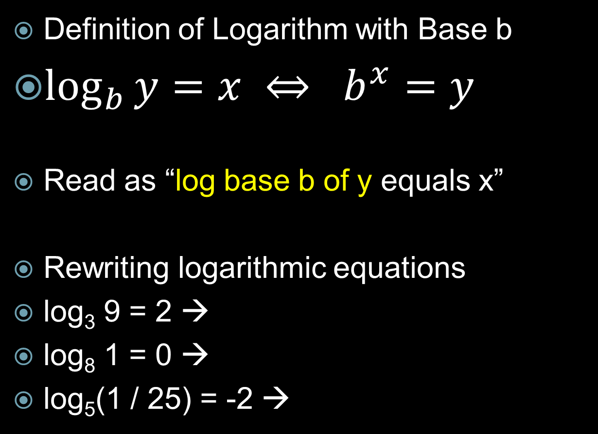
7.4 Evaluate Logarithms and Graph Logarithmic Functions
Definition of Logarithm with Base b
$\log_{b}{y}=x ⇔ b^{x}=y$
Read as “log base b of y equals x”
Rewriting logarithmic equations
log₃ 9 = 2 →
log₈ 1 = 0 →
log₅(1 / 25) = -2 →
Notes:
3² = 9
8⁰ = 1
5⁻² = 1/25

Slide 28

7.4 Evaluate Logarithms and Graph Logarithmic Functions
Special Logs
  log_{b} 1 = 0
  log_{b} b = 1
Evaluate
  log₄ 64
  $log2\frac{1}{8}$
  log_{1/4} 256
Notes:
Rewrite log_{b} 1 = 0 → b⁰ = 1
Rewrite log_{b} b = 1 → b¹ = b
Rewrite log₄ 64 = x → 4^{x} = 64 → x = 3
Rewrite log₂ 0.125 = x → 2^{x} = 1/8 → x = -3
Rewrite log_{1/4} 256 = x → (¼)^{x} = 256 → 4^{-x} = 256 → 4^{-x} = 4⁴ → -x = 4 → x = -4

Slide 29
7.4 Evaluate Logarithms and Graph Logarithmic Functions
Using a calculator
Common Log (base 10)
  log₁₀ x = log x
  Find log 12
Natural Log (base e)
  log_{e} x = ln x
  Find ln 2
Notes:
1.0792
0.6931

Slide 30

7.4 Evaluate Logarithms and Graph Logarithmic Functions
When the bases are the same, the base and the log cancel
$5^{\log_{5}{7}}=7$
$\log_{3}{{81}^{x}}$
$=\log_{3}{3^{4x}}$
$=4x$

Slide 31
7.4 Evaluate Logarithms and Graph Logarithmic Functions
Finding Inverses of Logs
y = log₈ x
x = log₈ y Switch x and y
y = 8^{x} Rewrite to solve for y
To graph logs
  Find the inverse
  Make a table of values for the inverse
  Graph the log by switching the x and y coordinates of the inverse.

Slide 32
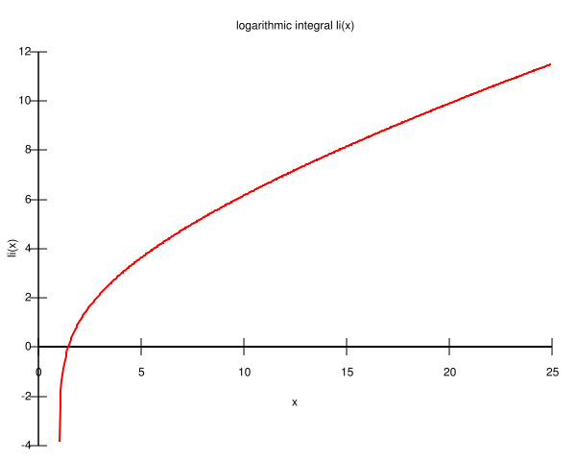
7.4 Evaluate Logarithms and Graph Logarithmic Functions
Properties of graphs of logs
y = log_{b} (x – h) + k
  x = h is vert. asymptote
  Domain is x > h
  Range is all real numbers
  If b > 1, graph rises
  If 0 < b < 1, graph falls

Slide 33
7.4 Evaluate Logarithms and Graph Logarithmic Functions
Graph
  y = log₂ x
  Inverse
  x = log₂ y
  y = 2^{x}
x | y
-3 | 1/8
-2 | ¼
-1 | ½
0 | 1
1 | 2
2 | 4
3 | 8
Notes:
Graph the points with x and y switched
(1/8, -3)
(1/4, -2)
(1/2, -1)
(1, 0)
(2, 1)
(4, 2)
(8, 3)

Slide 34
Quiz
7.4 Homework Quiz

Slide 35

7.5 Apply Properties of Logarithms
Product Property
  $\log_{b}{uv}=\log_{b}{u}+\log_{b}{v}$
Quotient Property
  $\log_{b}{\frac{u}{v}}=\log_{b}{u}−\log_{b}{v}$
Power Property
  $\log_{b}{u^{n}}=n\log_{b}{u}$

Slide 36

7.5 Apply Properties of Logarithms
Use log₉ 5 = 0.732 and log₉ 11 = 1.091 to find
  $\log_{9}{\frac{5}{11}}$
  log₉ 55
  log₉ 25
Notes:
log₉ 5/11 → log₉ 5 - log₉ 11 → 0.732 – 1.091 → -0.359
log₉ 55 → log₉ (5·11) → log₉ 5 + log₉ 11 → 0.732 + 1.091 → 1.823
log₉ 25 → log₉ 5² → 2 log₉ 5 → 2(0.732) → 1.464

Slide 37
7.5 Apply Properties of Logarithms
Expand: log₅ 2x⁶
Condense: 2 log₃ 7 – 5 log₃ x
Notes:
log₅ 2 + log₅ x⁶ → log₅ 2 + 6 log₅ x
log₃ 7² - log₃ x⁵ → log₃ (49/x⁵)

Slide 38

7.5 Apply Properties of Logarithms
Change-of-Base Formula
  $\log_{c}{u}=\frac{\log_{b}{u}}{\log_{b}{c}}$
Evaluate log₄ 8
Notes:
log₄ 8 = (log 8)/(log 4) = 1.5

Slide 39
Quiz
7.5 Homework Quiz

Slide 40
7.6 Solve Exponential and Logarithmic Equations
Solving Exponential Equations
  Method 1) if the bases are equal, then exponents are equal
  2^{4x} = 32^{x-1}
Notes:
2^{4x} = 2^{5(x-1)} → 4x = 5(x-1) → 4x = 5x – 5 → -x = -5 → x = 5

Slide 41
7.6 Solve Exponential and Logarithmic Equations
Solving Exponential Equations
  Method 2) take log of both sides
  4^{x} = 15
  5^{x+2} + 3 = 25
Notes:
log 4^{x} = log 15 → x log 4 = log 15 → x = log 15 / log 4 → x = 1.95
5^{x+2} = 22 → log 5^{x+2} = log 22 → (x+2) log 5 = log 22 → x+2 = log 22 / log 5 → x = -0.079

Slide 42
7.6 Solve Exponential and Logarithmic Equations
Solving Logarithmic Equations
  Method 1) if the bases are equal, then logs are equal
  log₃ (5x – 1) = log₃ (x + 7)
Notes:
5x-1=x+7 → 4x = 8 → x = 2

Slide 43
7.6 Solve Exponential and Logarithmic Equations
Solving Logarithmic Equations
  Method 2) exponentiating both sides
    Make both sides exponents with the base of the log
  log₄ (x + 3) = 2
Notes:
4^(log₄ (x+3)) = 4^2 → x+3 = 16 → x = 13

Slide 44

7.6 Solve Exponential and Logarithmic Equations
$\log_{2}{2x}+\log_{2}{(x−3)}=3$
Notes:
$$\log_{2}{2x}+\log_{2}{(x−3)}=3$$
$$\log_{2}\left(2x⋅\left(x−3\right)\right)=3$$
$$2x\left(x−3\right)=2^{3}$$
$$2x^{2}−6x −8=0$$
$$x^{2}−3x−4=0$$
$$\left(x−4\right)\left(x+1\right)=0$$
$$x−4=0, x+1=0$$
$$x=4, −1$$
$$−1 extraneous$$
Solution x=4

Slide 45
Quiz
7.6 Homework Quiz

Slide 46
7.7 Write and Apply Exponential and Power Functions
Just as 2 points determine a line, so 2 points will determine an exponential equation.

Slide 47
7.7 Write and Apply Exponential and Power Functions
Exponential Function
  y = a b^{x}
If given 2 points
  Fill in both points to get two equations
  Solve for a and b by substitution

Slide 48
7.7 Write and Apply Exponential and Power Functions
Find the exponential function that goes through (-1, 0.0625) and (2, 32)
Notes:
0.0625 = ab⁻¹ → 0.0625 = a/b → a = 0.0625b
32 = ab²
Substitute
32 = (0.0625b)b² → 32 = 0.0625b³ → 512 = b³ → b = 8
a = 0.0625b → a = 0.0625(8) = 0.5
y = 0.5 * 8^{x}

Slide 49
7.7 Write and Apply Exponential and Power Functions
Steps if given a table of values
  Find ln y of all points
  Graph ln y vs x
  Draw the best fit straight line
  Pick two points on the line and find equation of line (remember to use ln y instead of just y)
  Solve for y
OR use the ExpReg feature on a graphing calculator
  Enter points in STAT → EDIT
  Go to STAT → CALC → ExpReg → Enter → Enter

Slide 50
7.7 Write and Apply Exponential and Power Functions
Writing a Power Function
  y = a x^{b}
Steps are the same as for exponential function
  Fill in both points to get two equations
  Solve for a and b by substitution

Slide 51
7.7 Write and Apply Exponential and Power Functions
Write power function through (3, 8) and (9, 12)
Notes:
8 = a3^{b} → a = 8 / 3^{b}
12 = a 9^{b}
Substitute
12 = (8/3^{b})9^{b} → 12 = 8 (9^{b}/3^{b}) → 12 = 8 (9/3)^{b} → 12 = 8 3^{b} → 12/8 = 3^{b} → log 3/2 = log 3^{b} → log 3/2 = b log 3 → b = log 3/2 / log 3 → b = 0.369
a = 8/3^{b} → a = 8 / 3^{0.369} → a = 16/3
y = 16/3 x^{0.369}

Slide 52
7.7 Write and Apply Exponential and Power Functions
Steps if given a table of values
  Find ln y and ln x of all points
  Graph ln y vs ln x
  Draw the best fit straight line
  Pick two points on the line and find equation of line (remember to use ln y and ln x instead of just y)
  Solve for y
OR use the PwrReg feature on a graphing calculator
  Enter points in STAT → EDIT
  Go to STAT → CALC → PwrReg → Enter → Enter

Slide 53
Quiz
7.7 Homework Quiz

